Slide 1
Arduino based Color Sorting Machine
St. Francis Institute of Technology
Information Technology
IoT Mini Project (ITL504)
Shweta Pai 20
Malcolm D’souza 24
Rutvi Shah 33

Slide 2
Introduction
Now a day’s industrial area requires demand for automation in order to reduce human efforts and time.
It becomes complex to manually segregate various objects such as pebbles,fruits etc…and many small coloured components.
Since chances of missing out objects or going wrong is more.

Slide 3
Introduction contd.
Proposed solution:
We plan to develop a system….
That can sort component or any other objects based on colour.
The system detects colour and segregates the object in the respective container.
Also a count of the number of objects is maintained.
Which is cost effective and time saver equipment.

Slide 4
Literature Review
Most of them have proposed a model previously for just segregating objects according to the colour.
However, our proposed system,has an additional benefit as the number of pebbles also gets counted .

Slide 5
Problem Statement
This mini-project aims to develop –
An IoT based colour separator for segregating objects in industries.
It saves considerable amount of time.
As well as counts the number of objects based on colour.

Slide 6
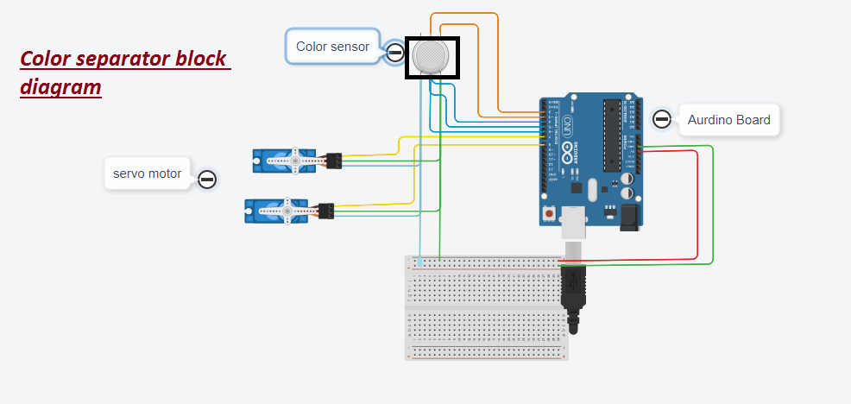
System Design

Slide 7
System Requirements
Hardware requirements :
Arduino uno
2 Servo motors
Color sensor
Software requirements
Android studio
Arduino IDE

Slide 8
System Requirements contd.
Approximate cost of components
Sr no. | Components | Quantity | Cost in Rs.
1. | Arduino UNO | 1 | 450
2. | Color sensor | 1 | 478
3. | Servo motor | 2 | 195-200 per piece
4. | Cardboard | 1/2 | 100
5. | Pebbles | 1 | 100
 | Total |  | 1,528/-

Slide 9
References
https://ijritcc.org/download/conferences/ICMTEST_2016/ICMTEST_2016_Track/1462861796_10-05-2016.pdf
https://www.ripublication.com/ijaer18/ijaerv13n10_20.pdf
https://www.ijiert.org/admin/papers/1524213053_NCMTEE-2K18.pdf

